Slide 1
Applied Data Science 2
Dr Ashley SpindLer
Semester A, 2022

Slide 2
Lecture 5 - Outcomes
Understand the essentials around building neural networks to model sequences of data
Explore the construction of recurrent cells and RNN models

Slide 3
Predicting the future?
Where will the ball go next?

Slide 4
Predicting the future?
Where will the ball go next?

Slide 5
Predicting the future?
Where will the ball go next?

Slide 6
Predicting the future?
Where will the ball go next?

Slide 7
Predicting the future?
Where will the ball go next?

Slide 8
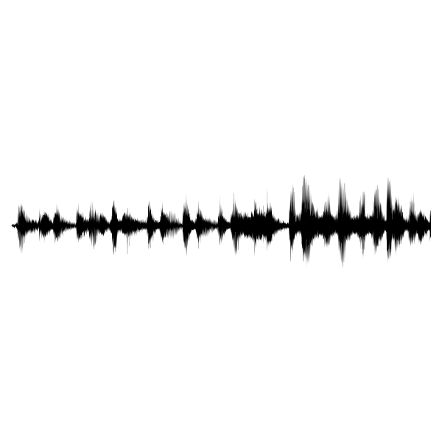
Sequential Data
e.g. Audio Data

Slide 9
Sequential Data
e.g. Audio Data

Slide 10
Text is sequential data
7PAM2001 – Applied Data Science 2

Slide 11
Text is sequential data
Characters: 7, P, A, M, 2, 0, 0, 1
Words: Applied, Data, Science, 2

Slide 12
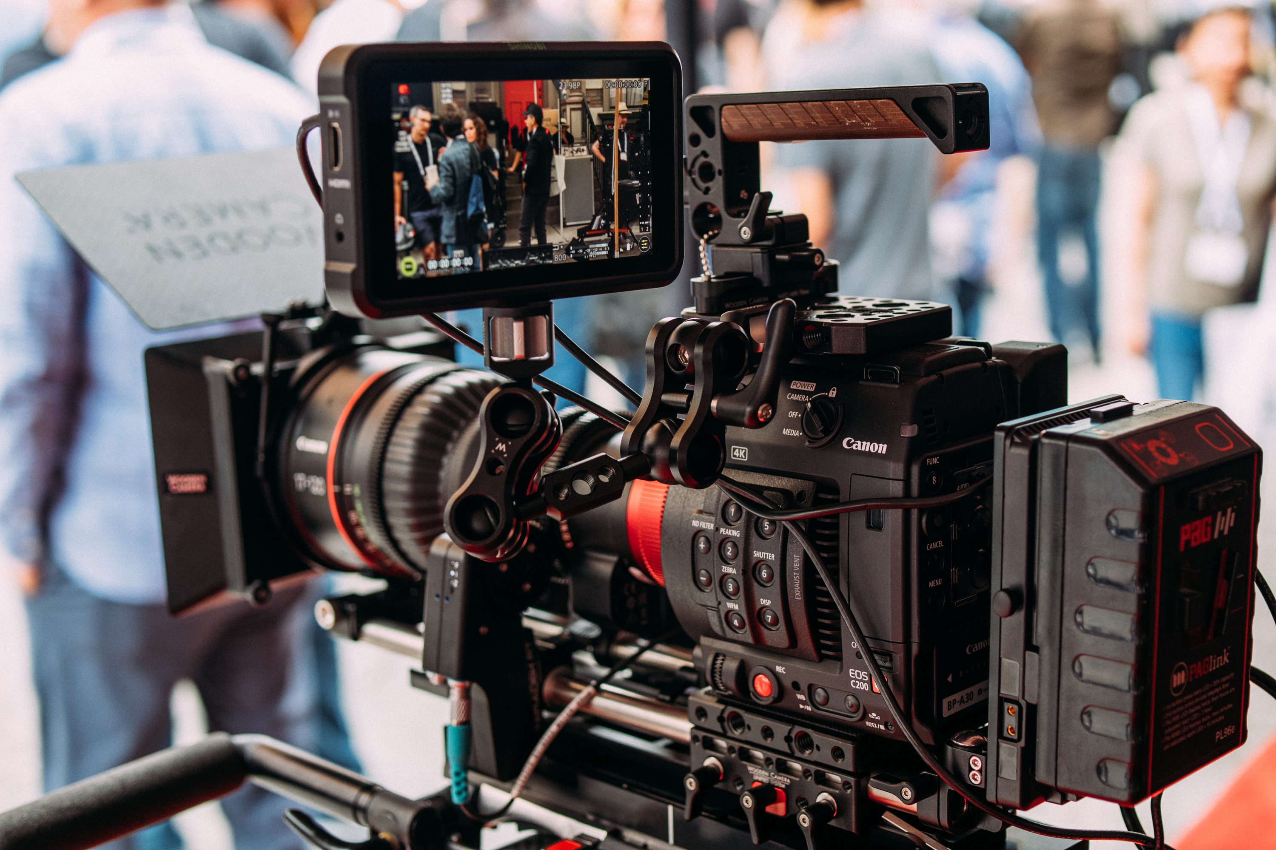
Sequential data is everywhere

Slide 13
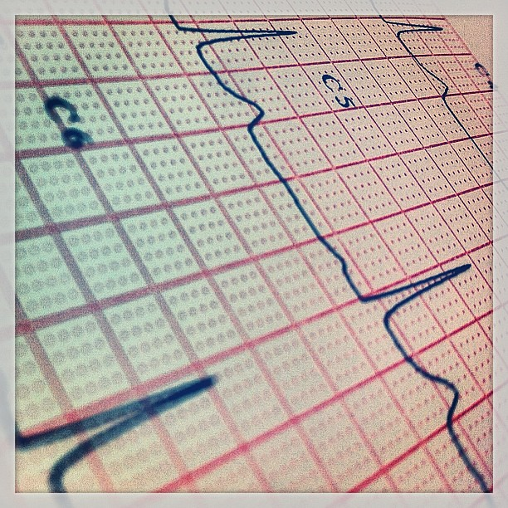
Sequential data is everywhere

Slide 14

Sequential data is everywhere

Slide 15
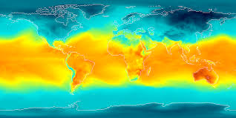
Sequential data is everywhere

Slide 16
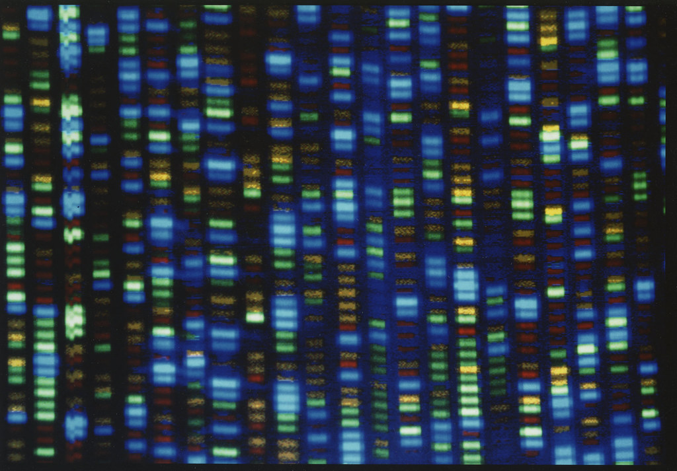
Sequential data is everywhere

Slide 17
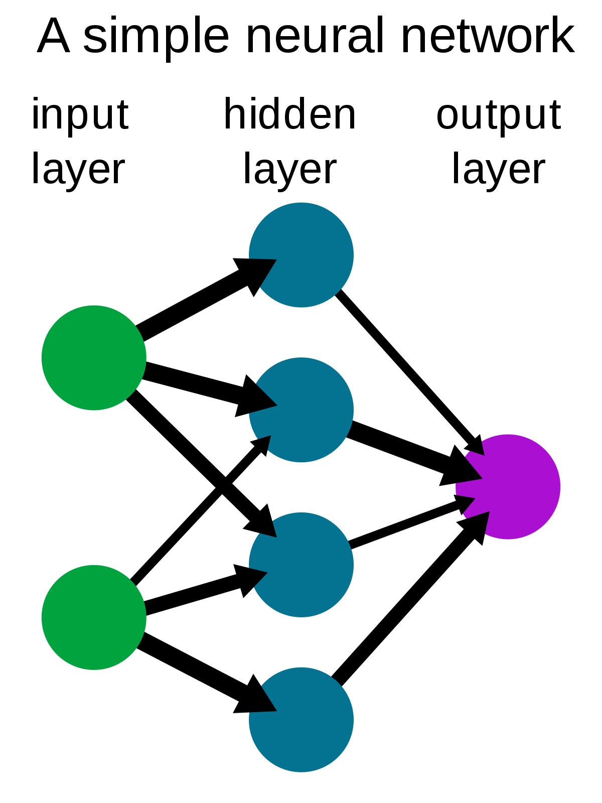
Applications of Sequence Modelling
Feed Forward Network:
e.g. Binary Classification
Is this a Cat or a Dog?

Slide 18
Applications of Sequence Modelling
Feed Forward Network:
Sequence classification
e.g. Binary Classification
Is this a Cat or a Dog?
e.g., Sentiment Analysis

Slide 19
Applications of Sequence Modelling
Feed Forward Network:
Sequence classification
Sequence Generation
e.g. Binary Classification
Is this a Cat or a Dog?
e.g., Sentiment Analysis
e.g. Image Captioning

Slide 20
Applications of Sequence Modelling
Feed Forward Network:
Sequence classification
Sequence Generation
Sequence to Sequence
e.g. Binary Classification
Is this a Cat or a Dog?
e.g., Sentiment Analysis
e.g. Image Captioning
e.g. Language Translation

Slide 21

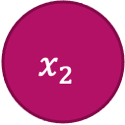
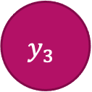

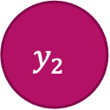

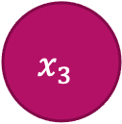
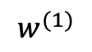
Recurrent Neurons
Feed Forward Perceptron
$$w^{(1)}$$
$$x_{1}$$
$$y_{1}$$
$$x_{2}$$
$$y_{2}$$
$$x_{3}$$
$$y_{3}$$
$$x_{n}$$

Slide 22


Recurrent Neurons
Feed Forward Perceptron
$$x_{t}$$
$$y_{t}$$

Slide 23


Recurrent Neurons
Feed Forward Perceptron
$$y_{t}$$
$$x_{t}$$

Slide 24

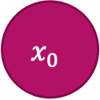
Recurrent Neurons
Feed Forward Perceptron
$$y_{t}$$
$$y_{0}$$
$$x_{t}$$
$$x_{0}$$

Slide 25


Recurrent Neurons
Feed Forward Perceptron
$$y_{t}$$
$$y_{0}$$
$$y_{1}$$
$$x_{t}$$
$$x_{0}$$
$$x_{1}$$

Slide 26
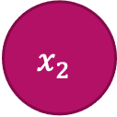
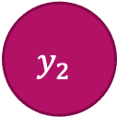
Recurrent Neurons
Feed Forward Perceptron
$$y_{t}$$
$$y_{0}$$
$$y_{1}$$
$$y_{2}$$
$$x_{t}$$
$$x_{0}$$
$$x_{1}$$
$$x_{2}$$

Slide 27
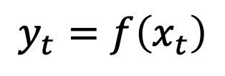
Recurrent Neurons
Feed Forward Perceptron
$$y_{t}$$
$$y_{0}$$
$$y_{1}$$
$$y_{2}$$
$$y_{t}=f\left(x_{t}\right)$$
$$x_{t}$$
$$x_{0}$$
$$x_{1}$$
$$x_{2}$$

Slide 28
Recurrent Neurons
$$y_{t}$$
$$y_{0}$$
$$y_{1}$$
$$y_{2}$$
$$y_{t}=f\left(x_{t}\right)$$
$$x_{t}$$
$$x_{0}$$
$$x_{1}$$
$$x_{2}$$
The output is only dependent on the current input time step

Slide 29
Memory is important
The cat sat on the mat.

Slide 30
Memory is important
The cat sat on the mat.

Slide 31
Memory is important
The cat sat on the mat.

Slide 32
Recurrent Neurons
The output of the current timestep should depend on the previous inputs
$$y_{t}$$
$$y_{0}$$
$$y_{1}$$
$$y_{2}$$
$$x_{t}$$
$$x_{0}$$
$$x_{1}$$
$$x_{2}$$

Slide 33
Recurrent Neurons
$$y_{t}$$
$$y_{0}$$
$$y_{1}$$
$$y_{2}$$
$$x_{t}$$
$$x_{0}$$
$$x_{1}$$
$$x_{2}$$

Slide 34
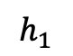
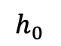
Recurrent Neurons
$$y_{t}$$
$$y_{0}$$
$$y_{1}$$
$$y_{2}$$
$$h_{0}$$
$$h_{1}$$
$$x_{t}$$
$$x_{0}$$
$$x_{1}$$
$$x_{2}$$

Slide 35
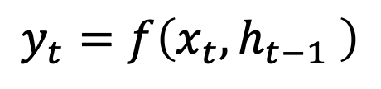
Recurrent Neurons
$$y_{t}$$
$$y_{0}$$
$$y_{1}$$
$$y_{2}$$
$$h_{0}$$
$$h_{1}$$
$$x_{t}$$
$$x_{0}$$
$$x_{1}$$
$$x_{2}$$
$$y_{t}=f\left(x_{t}, h_{t−1} \right)$$

Slide 36
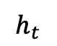
Recurrent Neurons
$$y_{t}$$
$$y_{0}$$
$$y_{1}$$
$$y_{2}$$
Outputs
$$h_{0}$$
$$h_{1}$$
Recurrent Cell
$$h_{t}$$
Memory
$$x_{t}$$
$$x_{0}$$
$$x_{1}$$
$$x_{2}$$
Inputs
$$y_{t}=f\left(x_{t}, h_{t−1} \right)$$

Slide 37
RNN State and Output
$$y_{t}$$
Outputs
RNN
$$h_{t}$$
Memory
$$x_{t}$$
Inputs

Slide 38
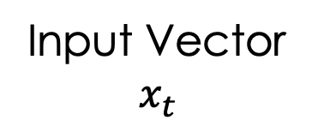
RNN State and Output
$$y_{t}$$
Outputs
RNN
$$h_{t}$$
Memory
$$x_{t}$$
Inputs
Input Vector
$$x_{t}$$

Slide 39
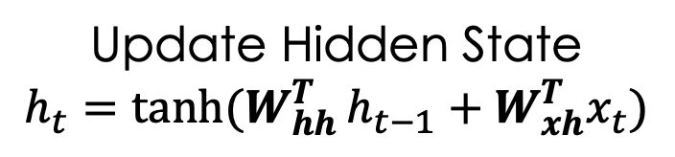
RNN State and Output
$$y_{t}$$
Outputs
Update Hidden State
$$h_{t}=\tanh{(W_{hh}^{T}}h_{t−1}+W_{xh}^{T}x_{t})$$
RNN
$$h_{t}$$
Memory
$$x_{t}$$
Inputs
Input Vector
$$x_{t}$$

Slide 40
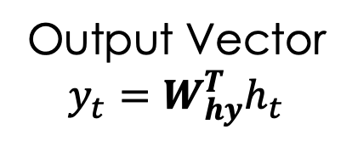
RNN State and Output
Output Vector
$$y_{t}=W_{hy}^{T}h_{t}$$
$$y_{t}$$
Outputs
Update Hidden State
$$h_{t}=\tanh{(W_{hh}^{T}}h_{t−1}+W_{xh}^{T}x_{t})$$
RNN
$$h_{t}$$
Memory
$$x_{t}$$
Inputs
Input Vector
$$x_{t}$$

Slide 41
Unfolding RNNS
$$y_{t}$$
RNN
$$x_{t}$$

Slide 42
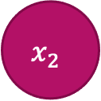
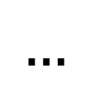


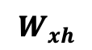
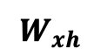



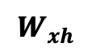

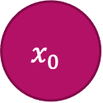
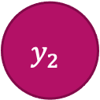
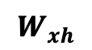
Unfolding RNNS
$$…$$
$$y_{t}$$
$$y_{0}$$
$$y_{1}$$
$$y_{2}$$
$$y_{t}$$
RNN
$$W_{xh}$$
$$W_{xh}$$
$$W_{xh}$$
$$W_{xh}$$
$$x_{t}$$
$$x_{0}$$
$$x_{1}$$
$$x_{2}$$
$$…$$
$$x_{t}$$

Slide 43
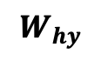
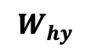
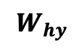
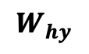
Unfolding RNNS
$$…$$
$$y_{t}$$
$$y_{0}$$
$$y_{1}$$
$$y_{2}$$
$$y_{t}$$
$$W_{hy}$$
$$W_{hy}$$
$$W_{hy}$$
$$W_{hy}$$
RNN
$$W_{xh}$$
$$W_{xh}$$
$$W_{xh}$$
$$W_{xh}$$
$$x_{t}$$
$$x_{0}$$
$$x_{1}$$
$$x_{2}$$
$$…$$
$$x_{t}$$

Slide 44
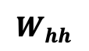
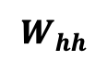
Unfolding RNNS
$$…$$
$$y_{t}$$
$$y_{0}$$
$$y_{1}$$
$$y_{2}$$
$$y_{t}$$
$$W_{hy}$$
$$W_{hy}$$
$$W_{hy}$$
$$W_{hy}$$
$$W_{hh}$$
$$W_{hh}$$
$$W_{hh}$$
RNN
$$W_{xh}$$
$$W_{xh}$$
$$W_{xh}$$
$$W_{xh}$$
$$x_{t}$$
$$x_{0}$$
$$x_{1}$$
$$x_{2}$$
$$…$$
$$x_{t}$$

Slide 45
Unfolding RNNS
Reuse the same weight matrices at each time step
$$…$$
$$y_{t}$$
$$y_{0}$$
$$y_{1}$$
$$y_{2}$$
$$y_{t}$$
$$W_{hy}$$
$$W_{hy}$$
$$W_{hy}$$
$$W_{hy}$$
$$W_{hh}$$
$$W_{hh}$$
$$W_{hh}$$
RNN
$$W_{xh}$$
$$W_{xh}$$
$$W_{xh}$$
$$W_{xh}$$
$$x_{t}$$
$$x_{0}$$
$$x_{1}$$
$$x_{2}$$
$$…$$
$$x_{t}$$

Slide 46
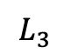
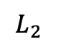
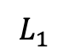
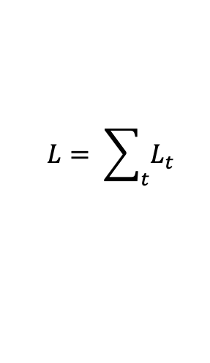
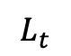
Unfolding RNNS - Losses
$$L= \sum_{t}{L_{t}}$$
$$L_{1}$$
$$L_{2}$$
$$L_{3}$$
$$L_{t}$$
$$…$$
$$y_{t}$$
$$y_{0}$$
$$y_{1}$$
$$y_{2}$$
$$y_{t}$$
$$W_{hy}$$
$$W_{hy}$$
$$W_{hy}$$
$$W_{hy}$$
$$W_{hh}$$
$$W_{hh}$$
$$W_{hh}$$
RNN
$$W_{xh}$$
$$W_{xh}$$
$$W_{xh}$$
$$W_{xh}$$
$$x_{t}$$
$$x_{0}$$
$$x_{1}$$
$$x_{2}$$
$$…$$
$$x_{t}$$

Slide 47
Sequence Modelling Criteria
The cat sat on the mat.
Given these words
Predict this word

Slide 48
Sequence Modelling Criteria
The cat sat on the mat.
Given these words
Predict this word
“Deep”
“Learning”

Slide 49
Sequence Modelling Criteria
The cat sat on the mat.
Given these words
Predict this word
“Deep”
“Learning”
Neural Networks can’t interpret words

Slide 50
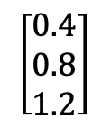
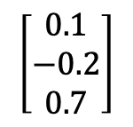
Sequence Modelling Criteria
The cat sat on the mat.
Given these words
Predict this word
$$\left[\begin{matrix}0.1 \\ −0.2 \\ 0.7\end{matrix}\right]$$
$$\left[\begin{matrix}0.4 \\ 0.8 \\ 1.2\end{matrix}\right]$$
“Deep”
“Learning”
Neural Networks can’t interpret words
We need numerical inputs

Slide 51
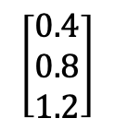
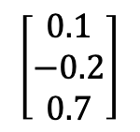
Language Encoding
$$\left[\begin{matrix}0.1 \\ −0.2 \\ 0.7\end{matrix}\right]$$
$$\left[\begin{matrix}0.4 \\ 0.8 \\ 1.2\end{matrix}\right]$$
“Deep”
“Learning”
Neural Networks can’t interpret words
We need numerical inputs

Slide 52
Language Encoding
$$\left[\begin{matrix}0.1 \\ −0.2 \\ 0.7\end{matrix}\right]$$
$$\left[\begin{matrix}0.4 \\ 0.8 \\ 1.2\end{matrix}\right]$$
“Deep”
“Learning”
Neural Networks can’t interpret words
We need numerical inputs
The
on
sat
cat
mat
Vocabulary or “Corpus”

Slide 53
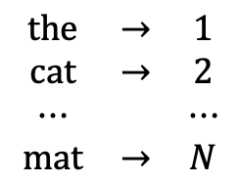
Language Encoding
$$\left[\begin{matrix}0.1 \\ −0.2 \\ 0.7\end{matrix}\right]$$
$$\left[\begin{matrix}0.4 \\ 0.8 \\ 1.2\end{matrix}\right]$$
“Deep”
“Learning”
Neural Networks can’t interpret words
We need numerical inputs
The
$$\begin{matrix}\text{t}\text{he} & → & 1 \\ \text{cat} & → & 2 \\ ⋯ & & ⋯ \\ \text{mat} & → & N\end{matrix}$$
on
sat
cat
mat
Vocabulary or “Corpus”
Word Indexing

Slide 54
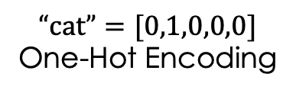
Language Encoding
$$\left[\begin{matrix}0.1 \\ −0.2 \\ 0.7\end{matrix}\right]$$
$$\left[\begin{matrix}0.4 \\ 0.8 \\ 1.2\end{matrix}\right]$$
“Deep”
“Learning”
Neural Networks can’t interpret words
We need numerical inputs
The
$$\begin{matrix}\text{t}\text{he} & → & 1 \\ \text{cat} & → & 2 \\ ⋯ & & ⋯ \\ \text{mat} & → & N\end{matrix}$$
on
sat
$$\text{“}\text{cat}\text{”}=[0,1,0,0,0]$$
One-Hot Encoding
cat
mat
Vocabulary or “Corpus”
Word Indexing
Embedding

Slide 55
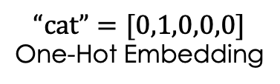
Language Encoding
$$\left[\begin{matrix}0.1 \\ −0.2 \\ 0.7\end{matrix}\right]$$
$$\left[\begin{matrix}0.4 \\ 0.8 \\ 1.2\end{matrix}\right]$$
“Deep”
“Learning”
Neural Networks can’t interpret words
We need numerical inputs
The
Learned Embedding
$$\begin{matrix}\text{t}\text{he} & → & 1 \\ \text{cat} & → & 2 \\ ⋯ & & ⋯ \\ \text{mat} & → & N\end{matrix}$$
The
on
sat
$$\text{“}\text{cat}\text{”}=[0,1,0,0,0]$$
One-Hot Embedding
on
cat
cat
sat
mat
mat
Vocabulary or “Corpus”
Word Indexing
Embedding

Slide 56

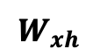


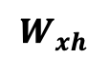









Gradient Troubles – Long Term Memory
RNNs are trained with Backpropagation Through Time. Computing the gradient w.r.t. $h_{0}$ involves many factors of $W_{hh}$ and repeated gradient computation.
$$h_{0}$$
$$h_{t}$$
$$W_{hh}$$
$$W_{hh}$$
$$W_{hh}$$
Vanishing Gradients become an issue for the early time steps – the model “Forgets” the inputs at the start of the sequence.
$$W_{xh}$$
$$W_{xh}$$
$$W_{xh}$$
$$W_{xh}$$
$$x_{0}$$
$$x_{1}$$
$$x_{2}$$
$$…$$
$$x_{t}$$
LSTMs try to solve this by controlling the flow of information…

Slide 57
Questions???

